Slide 1
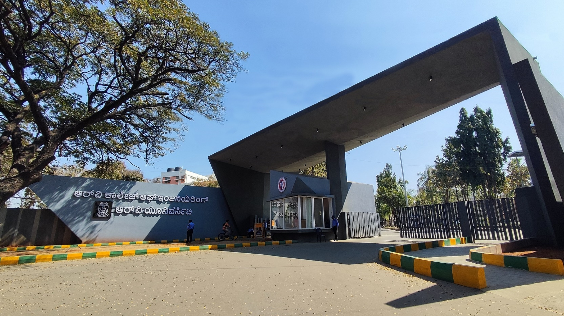
Scalable Agri-Assistance System
Theme - Environment

Slide 2


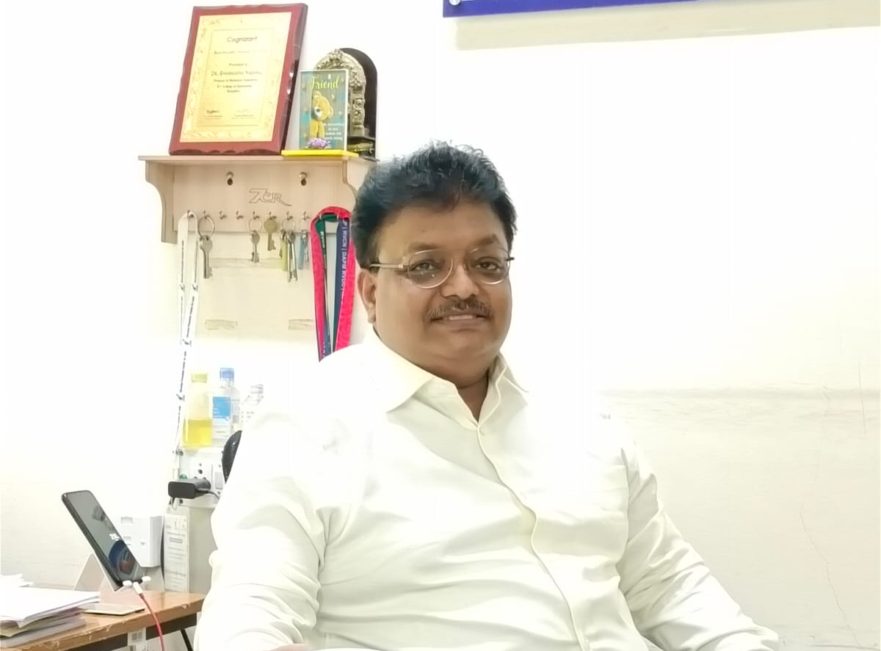
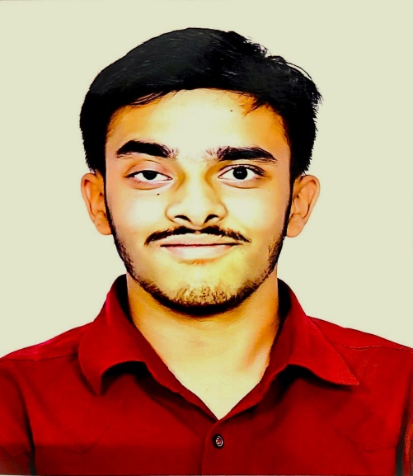
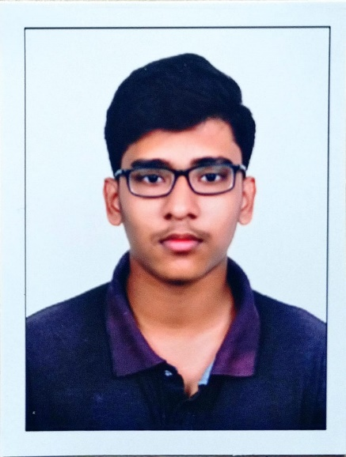
Scalable Agri-Assistance System
Pramath J
Samaraditya P H
Dr. Shanmukha Nagaraj
Dean Academics
Mechanical
Aditya Mallanagouda Yargal
Tejas N Naik

Slide 3
Introduction
Our project focuses on developing an Agri-assistance system aimed at empowering small-holder farmers with the tools and data necessary to efficiently manage their water, soil, energy and other resources. By integrating soil moisture sensors and real-time weather data, the system provides actionable insights for optimal irrigation and pesticide application, thereby reducing waste and preventing groundwater/soil contamination.
Inefficient irrigation wastes 40% of water and pesticide overuse contaminates 30% of groundwater. This project offers a cost-effective solution to optimize water use and prevent soil degradation, crucial for sustainable farming.

Slide 4
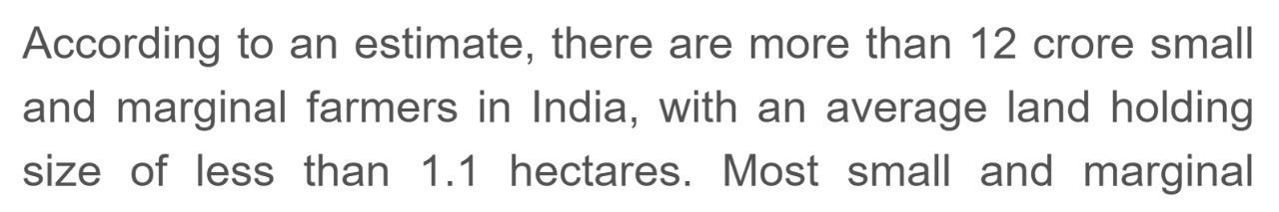
Literature Review
Decrease in Agricultural Holdings - pib.gov.in (03-March-2020)
As the average landholding of Indian farmers continues to decrease—now less than 1.08 hectares for most smallholder farmers—inefficient farming methods are becoming increasingly unaffordable.
With smaller plots of land, every input such as water, fertilizer, and energy must be used carefully to maximize productivity and reduce costs. Over-irrigation and excessive pesticide use not only waste these valuable resources but also degrade soil health, leading to lower yields and higher long-term costs.

Slide 5
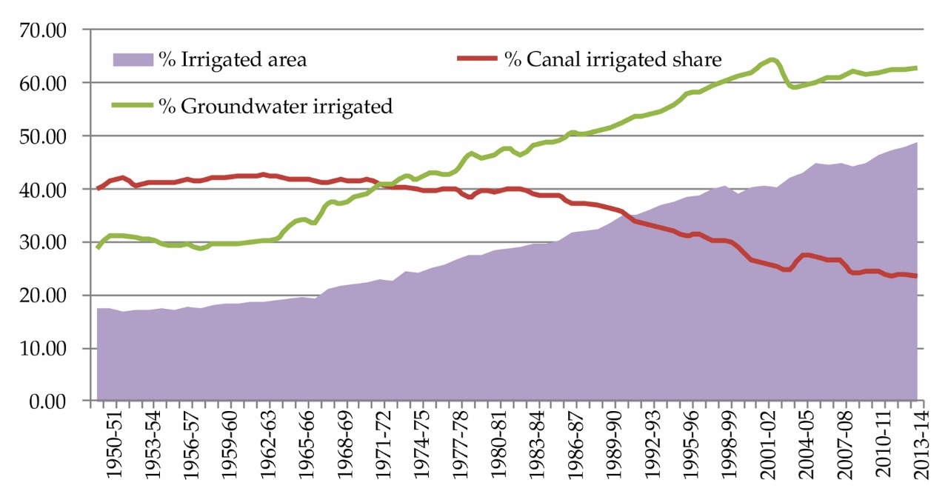
Wheat is one of the most widely grown crops in India and it is often over-irrigated. It typically requires 4 to 6 irrigations during its growth cycle, but farmers apply water more frequently than necessary, assuming it will increase yields.
Over-irrigation in wheat fields across Punjab and Haryana depletes groundwater by over 1 meter per year, threatening long-term water sustainability. These regions account for over 80% of India’s wheat production, making this issue a critical concern.
(Water and Agriculture in India- Dr. Vibha Dhawan)
Irrigation in India-www.researchgate.net
The increasing trend in the usage of groundwater is expected to deplete at a faster rate
(www.nipfp.org.in)

Slide 6
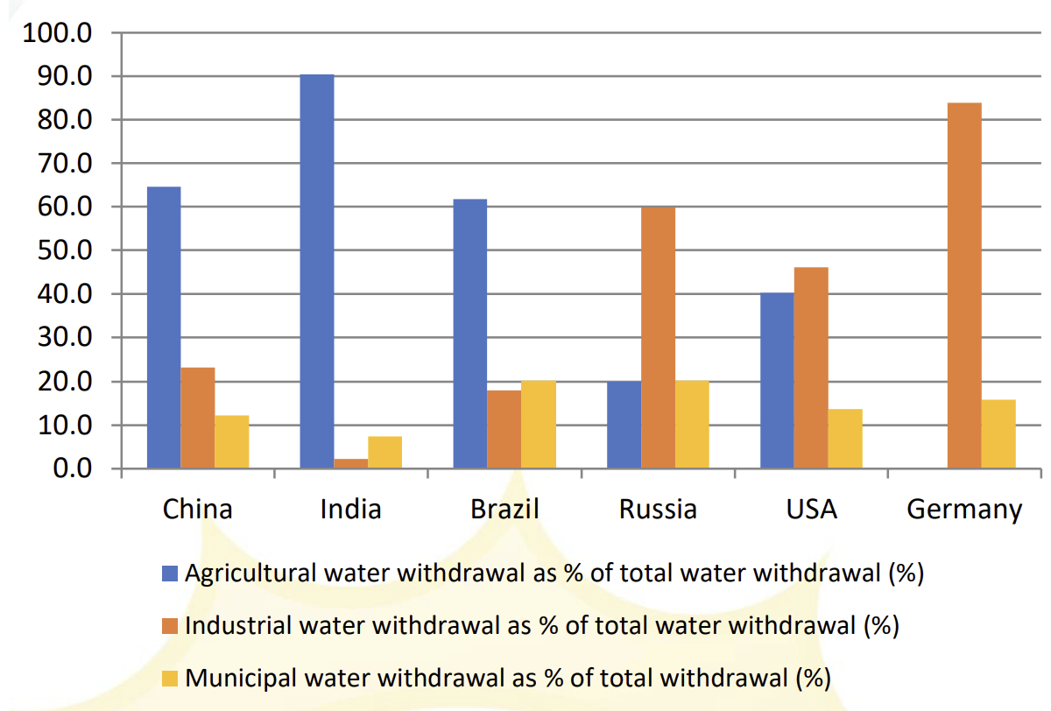
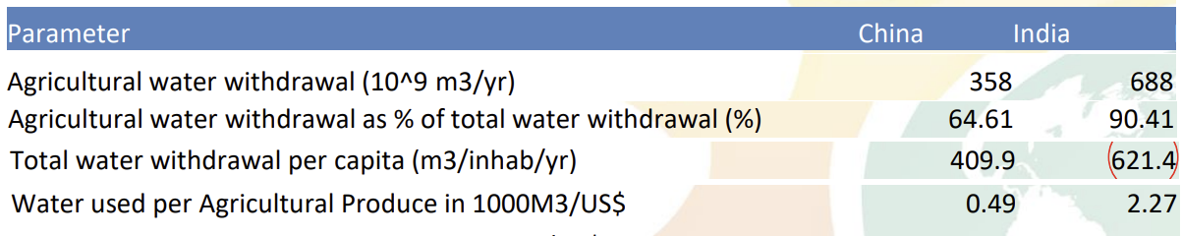
Despite China being the world's largest producer of many agricultural products, including rice, wheat; which require a lot of irrigation, the water withdrawal for agriculture in China is significantly lesser than India which highlights the concern of over-irrigation in India.

Slide 7
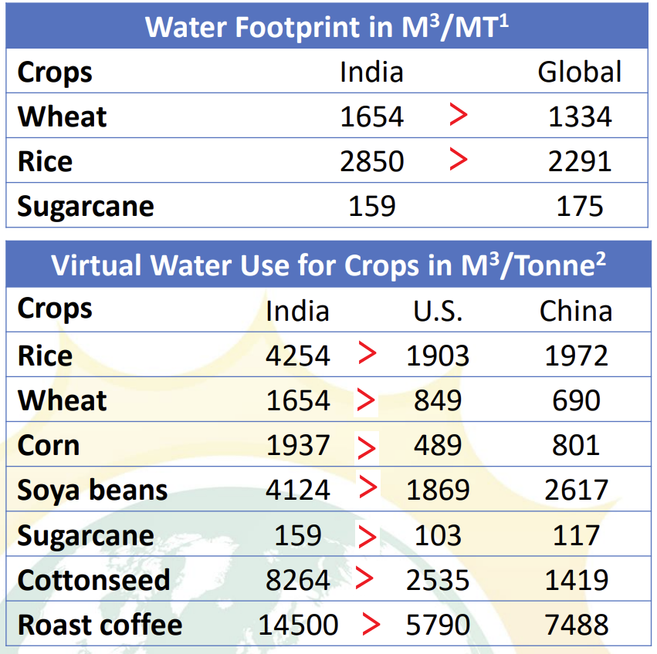
Annual precipitation in India is estimated to be around 4000 BCM, and the usable resource potential is 1870 BCM
India uses almost 700 BCM of water for agriculture every year, whereas China uses about 361 BCM.
It is expected to rise to 1200 BCM by the year 2050 if this continues
This highlights the efficient water usage policies of China and the inefficient water usage in India

Slide 8
Problem Definition
Small-holder farmers in India face significant challenges in managing water, soil, and pesticide use effectively.
Many must travel long distances to check soil quality and irrigation status, a process that is not only time-consuming and costly but also ineffective in conserving resources.
High-tech agricultural solutions that offer precision and efficiency exist, but they are too sophisticated and expensive for the average Indian farmer, putting critical data-driven approaches out of reach.

Slide 9
Without accessible tools, farmers rely on guesswork, leading to over-irrigation and improper pesticide application, which contributes to soil degradation and groundwater contamination.
Our project aims to provide a cost-effective, user-friendly system that enables farmers to monitor soil moisture and weather data remotely and control irrigation with the touch of a finger. This empowers farmers to optimize resources, reduce contamination risks, and increase crop productivity in a sustainable and accessible way.

Slide 10
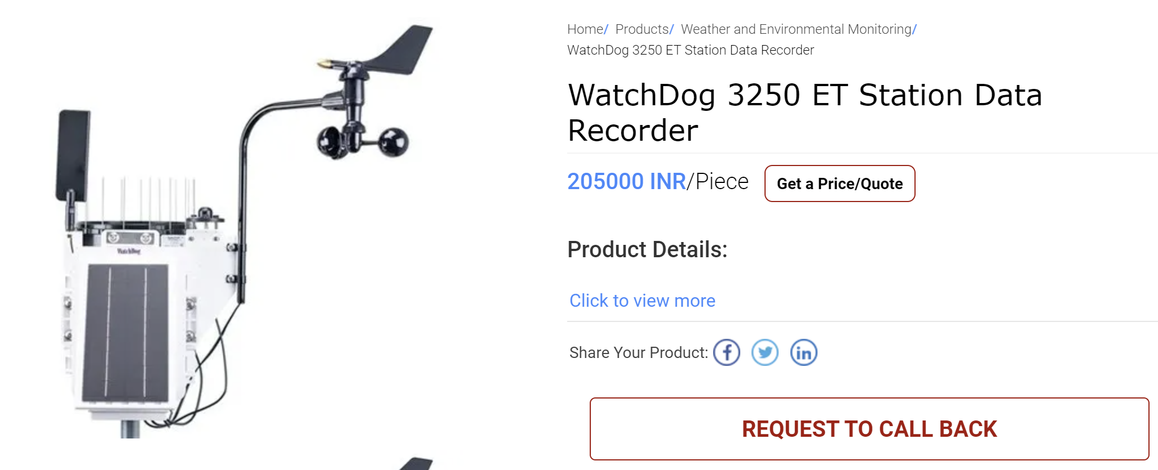
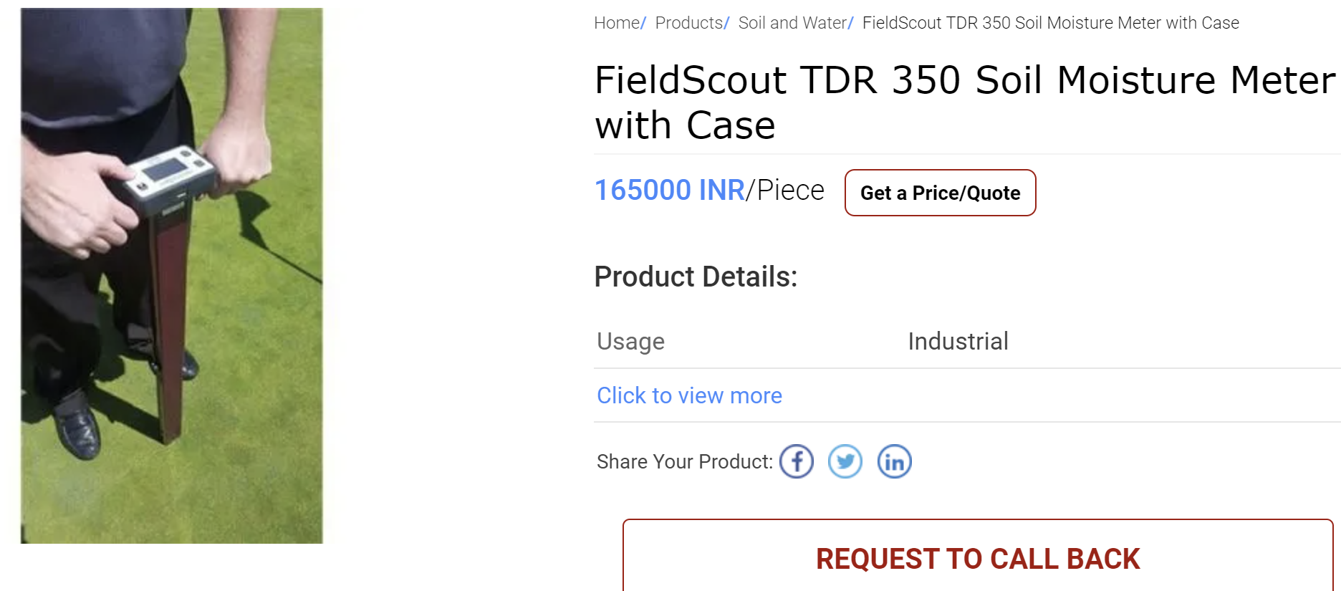
Previous attempts to solve it
Western countries have addressed this issue using expensive, high-tech equipment, but these solutions are not practical or affordable for Indian farmers.
Most smallholders need cost-effective, accessible technologies that fit their unique challenges and limited resources.

Slide 11
Objectives
Main Objective: To prevent water over-usage.
Specific Objectives:
Cost-Effective Solutions: Develop a smart irrigation system that utilizes affordable components and solar power, optimizing water usage while minimizing costs for scalable agricultural applications.
Enhance Water Efficiency: Implement an irrigation system that optimizes water usage based on soil moisture levels, reducing waste and conserving resources.
Remote Monitoring and Control: Create a user-friendly web interface that allows users to monitor soil moisture levels and control irrigation remotely via the ESP32.
Predictive Irrigation: Integrate machine learning algorithms to analyze weather data, enabling predictive irrigation decisions that adjust watering schedules based on forecasted conditions.
Sustainability: Promote sustainable farming practices by minimizing water consumption and reliance on external power sources, thereby supporting eco-friendly agriculture.

Slide 12
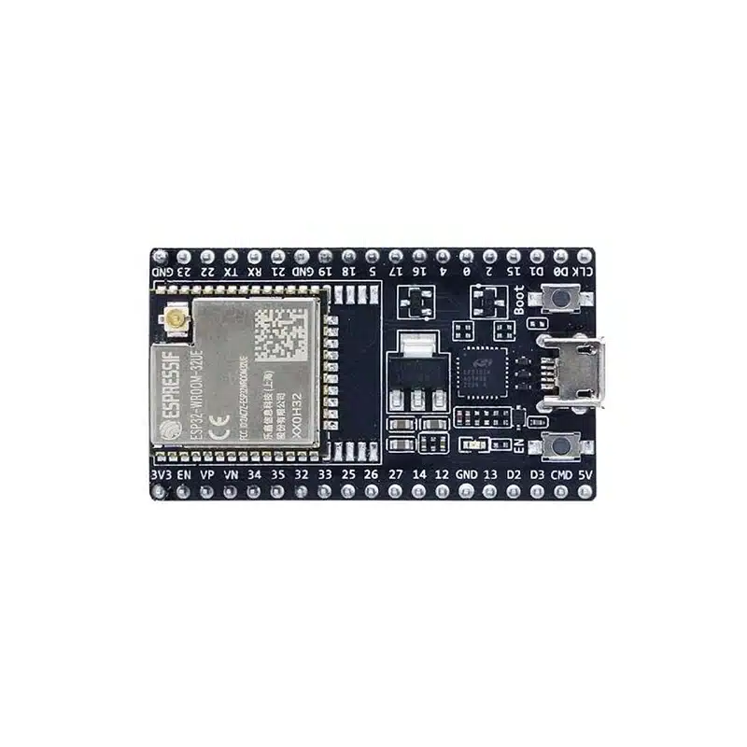
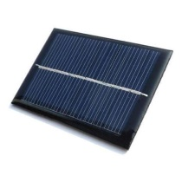
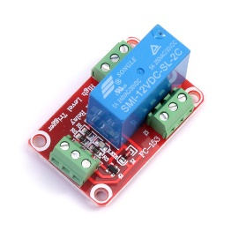
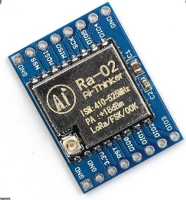
Methodology
System Design and Planning
Objective: Develop a low-cost, automated irrigation system using the ESP32 microcontroller, soil moisture sensors, and a website interface.
Power Source Selection: Design a solar-powered system with battery backup to ensure continuous operation. Solar panel and battery specifications will be chosen based on power requirements for the ESP32, sensors, and potential expansion to additional nodes.
Component Selection:
ESP32 Microcontroller: Selected for its low cost, Wi-Fi capability, and ease of integration with sensors.
Soil Moisture Sensors: Measure real-time soil moisture to control irrigation.
Relay Module: Interface with the irrigation pump to enable or disable water flow based on soil moisture data.
Communication Protocols: Determine protocols for ESP32 communication with the website to send real-time data and receive manual control inputs.

Slide 13
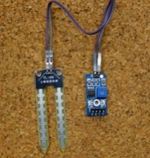
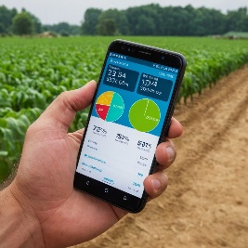
Methodology
Data Collection and Sensor Integration
Moisture Sensor Calibration: Test and calibrate moisture sensors in various soil types and moisture levels to ensure accuracy.
ESP32 Programming: Code the ESP32 to:
-Continuously monitor moisture sensor data.
-Transmit data to a remote database for real-time monitoring on the website.
-Activate the relay to trigger irrigation when moisture levels fall below a set threshold.
Data Transmission: Configure the ESP32 to transmit sensor readings to the cloud via Wi-Fi, ensuring reliable connectivity to the website.
Website Interface Development:
Real-Time Monitoring Dashboard:
-Display current moisture levels, system status, and irrigation history.
-Use a simple, user-friendly interface optimized for desktop and mobile viewing.
- Add controls for users to activate or deactivate the irrigation system manually, overriding automated responses if necessary.

Slide 14

Methodology
Backend Database: Store real-time and historical sensor data for trend analysis and potential future expansion to predictive irrigation models.
Automated Irrigation Algorithm:
Threshold-Based Control: Set threshold moisture levels that, when crossed, automatically activate irrigation.
Testing and Optimization:
-Adjust thresholds based on field conditions, crop type, and soil properties to ensure optimal water usage.
-Fine-tune the timing and duration of irrigation to prevent waterlogging or excessive dryness.
System Power and Sustainability Testing
Solar and Battery Optimization:
Size the solar panel and battery based on ESP32 and sensor energy consumption to ensure continuous operation, even during low-sunlight days.

Slide 15
Methodology
Power Management:
Implement a low-power mode on the ESP32 to conserve energy when data collection intervals are lower or when moisture levels are optimal.
Field Testing and Data Collection
Initial Testing- Test the system in controlled conditions to validate moisture readings, irrigation accuracy, and website communication.
Real-World Deployment:
Install the system in a field environment to test response accuracy under varying moisture levels, network stability, and battery performance.
Document data on water savings, energy usage, and irrigation effectiveness over an extended period.

Slide 16
Methodology
Analysis and Optimization
System Performance Review: Analyze data on irrigation frequency, soil moisture trends, and battery usage to refine system thresholds and improve reliability.
User Feedback Collection: Obtain feedback from test users (farmers, gardeners) on ease of use, website interface, and system responsiveness.
Final Adjustments: Optimize the software and hardware based on testing and feedback, preparing the system for full-scale deployment or commercialization.

Slide 17
Timeline
Week (1 to 2) - Phase 1: Planning and Design
Finalize project concept and objectives.
Design system architecture, sensor selection, and microcontroller setup.
Plan prototype development and identify key components.
Research on communication protocols, power supply options, and battery life.
Week (3 to 4) - Phase 1: Prototype Development
Begin initial assembly of hardware components.
Integrate sensors and microcontrollers for basic functionality.
Set up initial communication protocol and basic data transmission.
Conduct basic tests of the individual modules for data collection.
Week (5 to 6) - Phase 2: Prototype Testing and Demonstration
Build and test the temporary prototype (2 ESP32 modules, sensor data collection).
Test real-time data transmission and control of irrigation via relay.
Demonstrate the working of the prototype, focusing on scalability and connectivity.
Troubleshoot and optimize the system for better performance and reliability.

Slide 18
Timeline
Week (7 to 8) - Phase 2: Scalability and Portability Testing
Finalize testing of the prototype for connectivity between modules and scalability.
Demonstrate the ability to control water flow via remote nodes.
Week (9 to 10) - Phase 3: Field Testing and Refinements
Begin extensive field testing with soil moisture sensors and irrigation control.
Implement solar panels to make the modules self-sustaining.
Design custom 3D-printed casings for modules to protect components.
Refine communication and data transmission protocols based on real-world testing.
Week (11 to 12) - Phase 3: Final Testing and Adjustments
Conduct final tests to evaluate system performance in various conditions.
Fine-tune the user interface and system outputs for usability.
Make final design improvements based on feedback from field testing.
Prepare final documentation and presentation for project review.

Slide 19
Timeline
Week (13+)
Website Development:
Build a mobile-responsive website for remote monitoring and control.
Integrate cloud services for data storage and retrieval.
Testing and Integration:
Test UI and website functionality, gather feedback, and make improvements.
Integrate UI/website with the hardware system for real-time control.

Slide 20
Flowchart
System and Design Planning
Field Testing and Data Collection
Data Collection and Sensor Integration
System Power and Sustainability Testing
Analysis and Optimization
Website Interface Development
Automated Irrigation Algorithm

Slide 21
Proposed Outcomes
Efficient Water Management: By providing real-time soil moisture and weather data, we enable farmers to make precise irrigation decisions, ensuring crops receive the necessary amount of water while reducing wastage.
Prevent Groundwater Contamination: Through data-driven guidance on the timing of pesticide application, we aim to help farmers avoid contaminating groundwater, protecting both environmental and community health.
Increased Accessibility: Our goal is to make advanced farming technology accessible to smallholder farmers. By creating a user-friendly, remote-controlled system, we allow farmers to manage irrigation conveniently from a mobile device, reducing the need for frequent field visits.

Slide 22
Sustainable Agricultural Practices: By promoting efficient water and pesticide use, we support sustainable farming practices that safeguard natural resources, improve soil quality, and contribute to long-term food security.
Enhanced Crop Resilience and Productivity: With optimized irrigation and soil health protection, we aim to help farmers grow healthier, more resilient crops that can withstand changing weather conditions, ultimately boosting productivity and supporting their livelihoods.

Slide 23
Contribution to Additional studies
As awareness of water scarcity grows, these systems can set a benchmark for incorporating similar technologies in farming, leading to more precise and data-driven agricultural practices.
The effectiveness of smart irrigation can encourage policymakers to create regulations that promote water-saving technologies, shaping future agricultural policies.
By demonstrating how smart irrigation helps crops adapt to climate change, future initiatives may focus more on resilience strategies, enhancing food security.

Slide 24
Conclusion
Our project aims to provide an affordable and convenient solution for smallholder farmers by using sensor-based irrigation systems. By enabling real-time monitoring of soil moisture and weather conditions, farmers can optimize water usage, reducing waste and lowering costs associated with water and energy. The convenience of remote access through mobile devices means farmers can control irrigation without frequent trips to the field, saving time and labor. Additionally, by preventing over-irrigation and improper pesticide use, the system helps protect soil health and prevent groundwater contamination, supporting sustainable and efficient farming practices.

Slide 25
References
(03-March-2020) “Decrease in Agricultural Holdings” - pib.gov.in
Dr. Vibha Dhawan (2017) “Water and Agriculture in India”- oav.de/fileadmin/user_upload/5_Publikationen/5_Studien/170118_Study_Water_Agriculture_India.pdf
Rajini Jain & Prabhat Kishore (March-2020) “Irrigation in India: Status, Challenges and options”- researchgate.net/publication/340234257_Irrigation_in_India_Status_challenges_and_options
Rita Pandey (August-2014) “Groundwater Irrigation in Punjab” https://www.nipfp.org.in/media/medialibrary/2014/09/WP_2014_140.pdf#:~:text=The%20water%20tables%20in%20Punjab%20have%20been,year%20of%20excessive%20extraction)%20(World%20Bank%202010).&text=Punjab%20had%20the%20largest%20area%20experiencing%20such%20decline%20(Sekhri%2C%202012a).
C.V. Dharma Rao (2018) “Water use efficiency” nwm.gov.in/sites/default/files/1.%20National-water-mission-%20%20%20water-use-efficiency.pdf

Slide 26

Expected Outcome by the end of First Year
Our project is highly scalable, designed to evolve into a full-fledged mobile app with a simple, user-friendly interface, enabling farmers to remotely monitor and manage their irrigation needs. The app can easily integrate additional sensors, such as those for soil nutrients (NPK), pH, and temperature, providing deeper insights into soil health and optimizing water, fertilizer, and pesticide use and even a weather monitoring station instead of importing data from a 3rd party application.
As the system grows, predictive analytics using ai can be incorporated to suggest the best times for irrigation and pesticide application, enhancing decision-making and sustainability. This scalability ensures that our solution remains adaptable and cost-effective.

Slide 27


